Slide 1

G2M Cab Industry Case Study
21-July-2023

Slide 2
Background –G2M(cab industry) case study
XYZ is a private equity firm in US. Due to remarkable growth in the Cab Industry in last few years and multiple key players in the market, it is planning for an investment in Cab industry.
Objective : Provide actionable insights to help XYZ firm in identifying the right company for making investment.
The analysis has been divided into four parts:
Data Understanding
Profit Analysis
Seasonality Analysis
Recommendations for investment

Slide 3
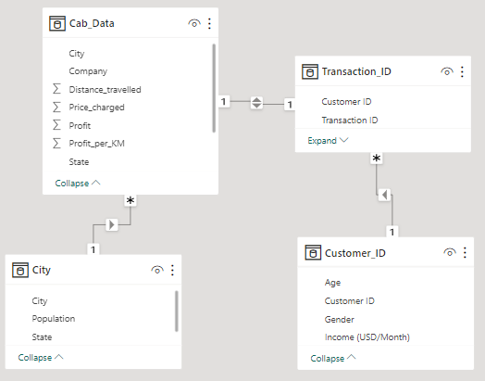
Data Exploration
17 Features
Timeframe of the data: 2016-01-31 to 2018-12-31
Total data points :359,392
Assumptions:
Outliers are present in Price_Charged feature but due to
unavailability of trip duration details ,we are not treating this as outlier.
Profit of rides are calculated keeping other factors constant and only
Price_Charged and Cost_of_Trip features used to calculate profit.
Users feature of city dataset is treated as number of cab users in the city.
we have assumed that this can be other cab users as well(including Yellow and
Pink cab)
Model view of relationships used to join each data sources.

Slide 4
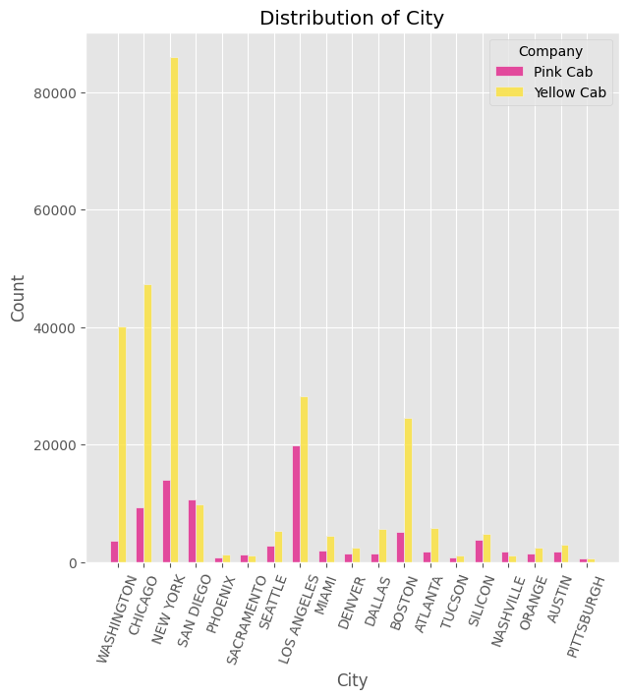
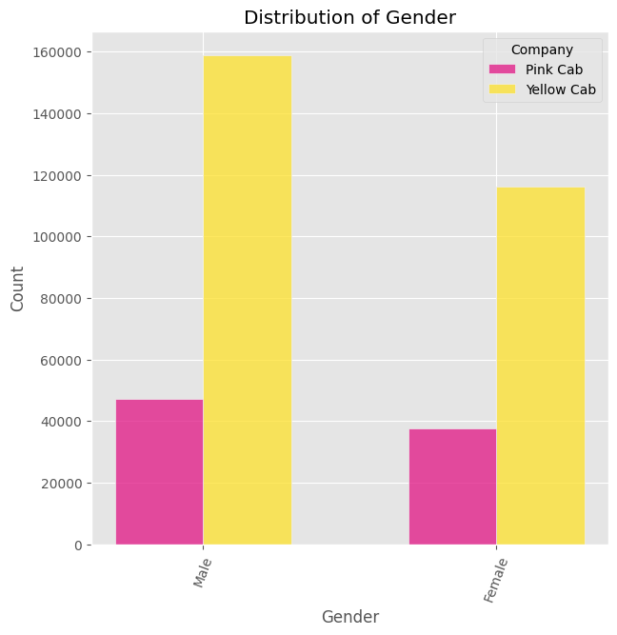
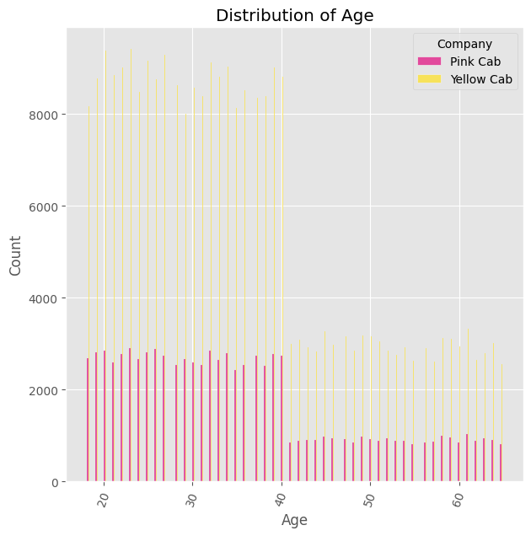
Data Exploration

Slide 5
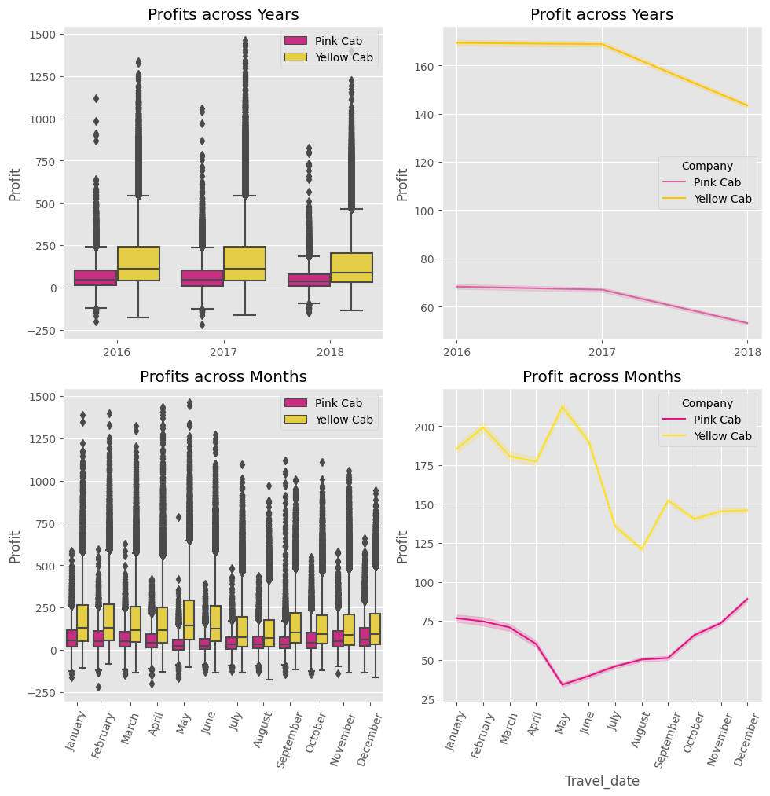
Profit Analysis
Profit Analysis
Yellow Cab has more yearly and monthly profits compared to Pink Cab.
Reasons can be:
Yellow Cab has more rides. Market share analysis required!
Yellow Cab charges more for the rides i.e. high profit rides. Price charged per Distance travelled analysis required!

Slide 6
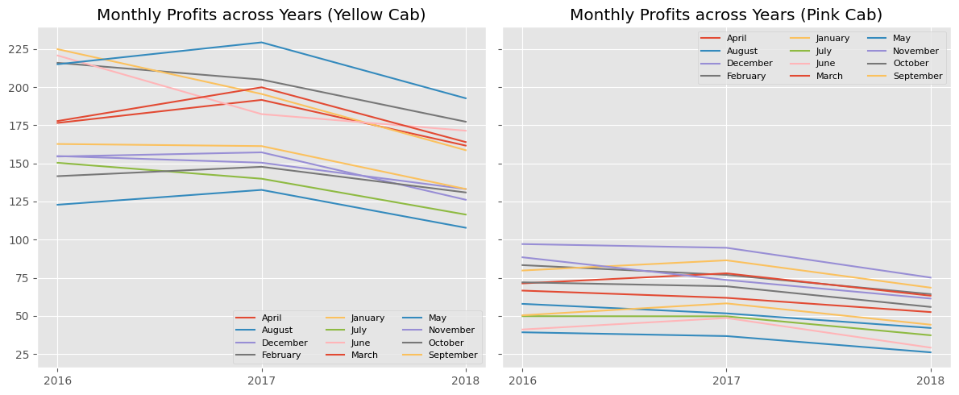
Monthly profits across Years

Slide 7
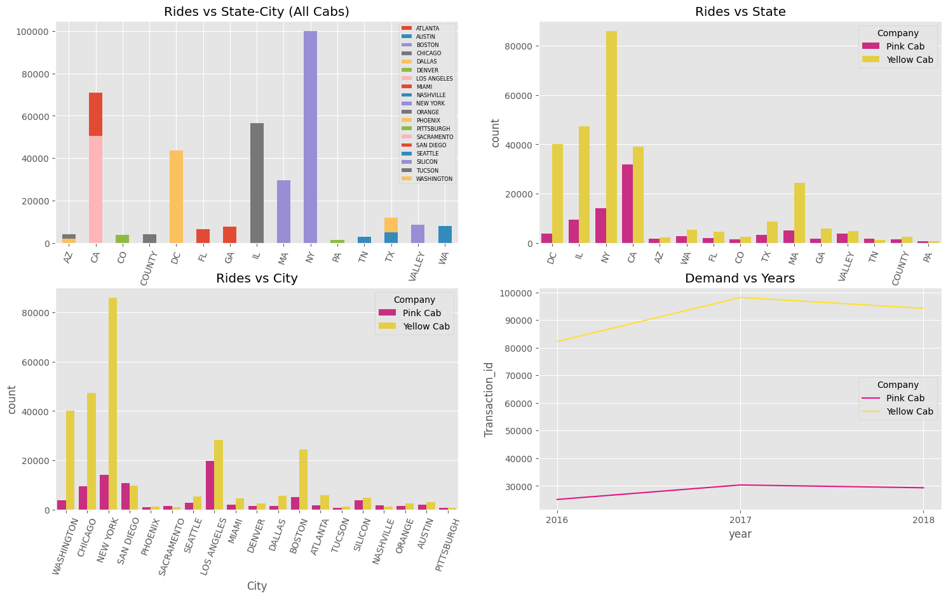
Profit Analysis - Market Share Insights
Yellow Cab's market share is greater than Pink Cab in most cities.
Demand for Yellow cabs keeps increasing compared to Pink Cabs.
The demand and market analysis justifies the higher profit margin of Yellow Cab compared to Pink Cab.

Slide 8
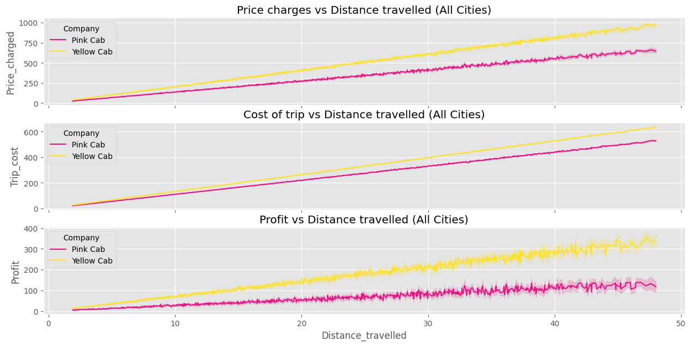
Profit Analysis - Profits Per KM Analysis
Yellow Cab generates more profits per KM distance travelled.
Yellow Cab charges more prices per KM in most major cities such as New York (Next Slide).
This explains the difference in profits between both the companies.

Slide 9
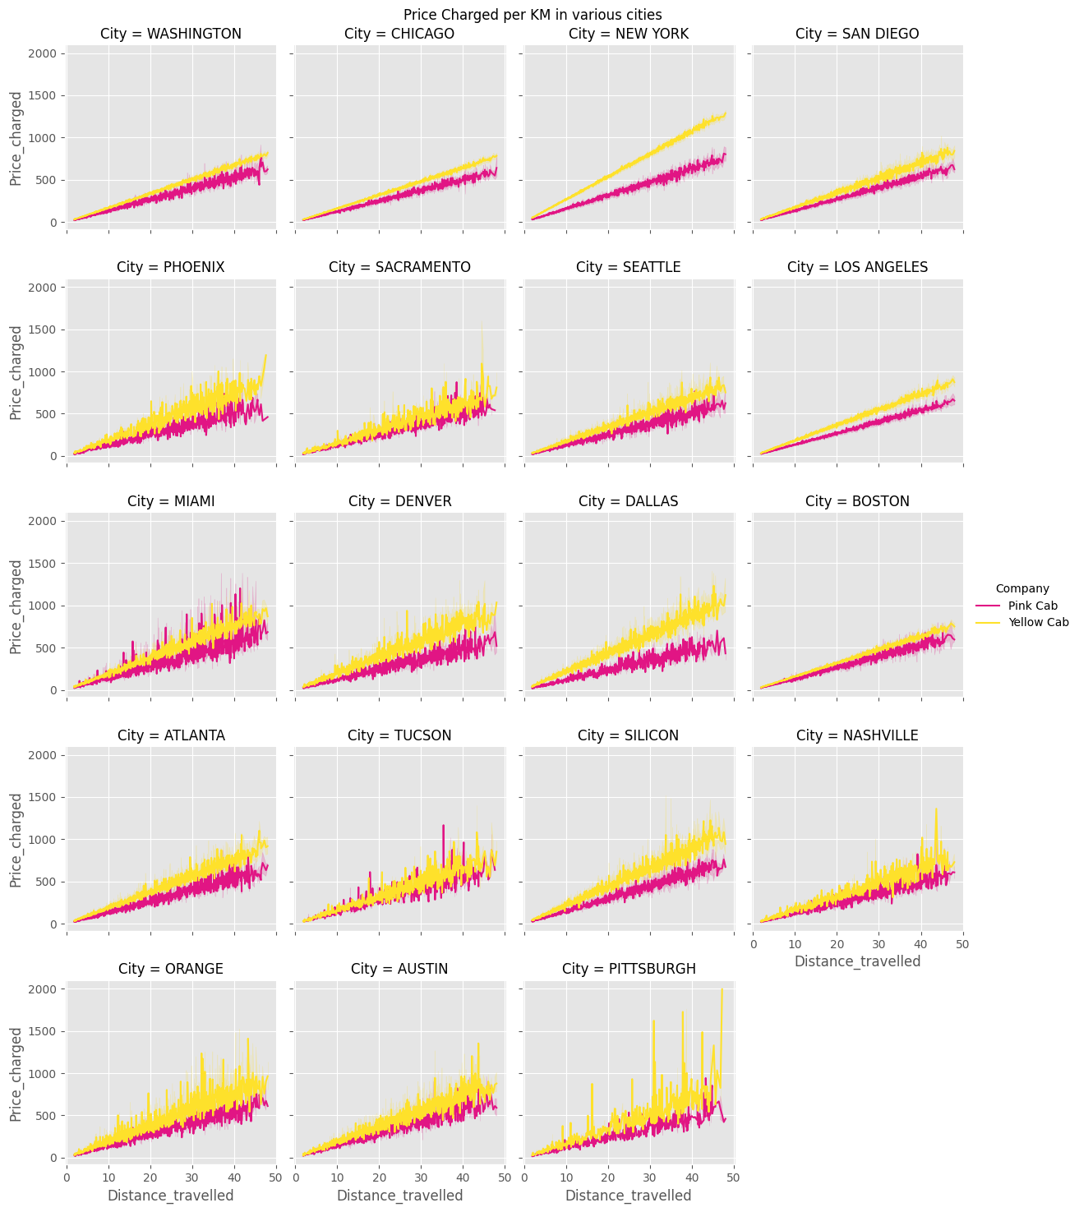
Profit Analysis - Profits Per KM Analysis

Slide 10
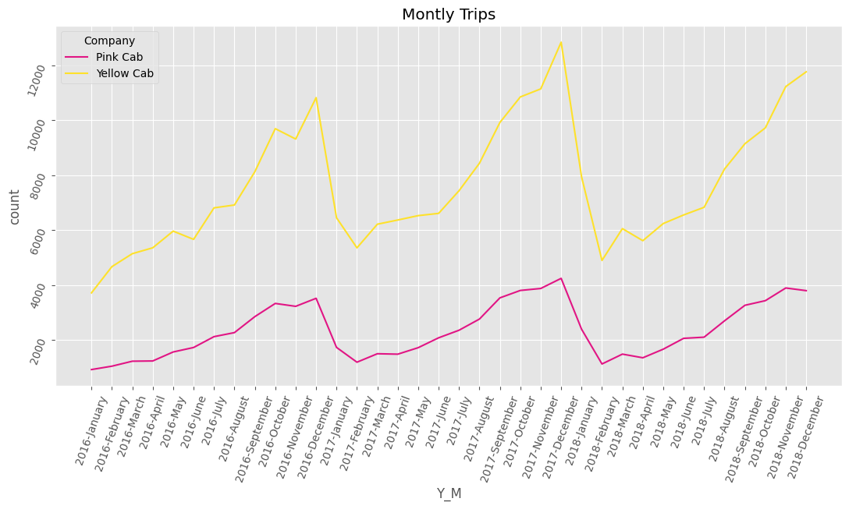
Seasonality Analysis
Graph shows clear signs of seasonality in cab data for both companies.
The number of trips at the month of February is the lowest and the number of trips at the month of December is the highest for all the years.
For both Cab companies, there is a slight upward trend throughout the years.

Slide 11

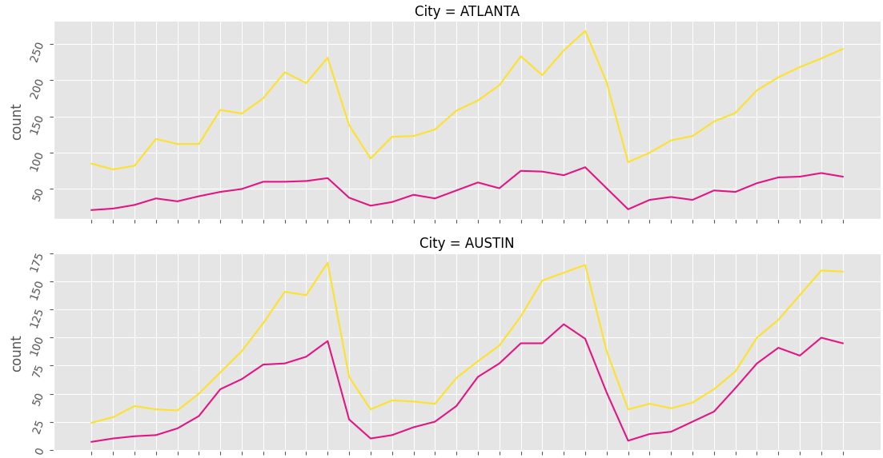
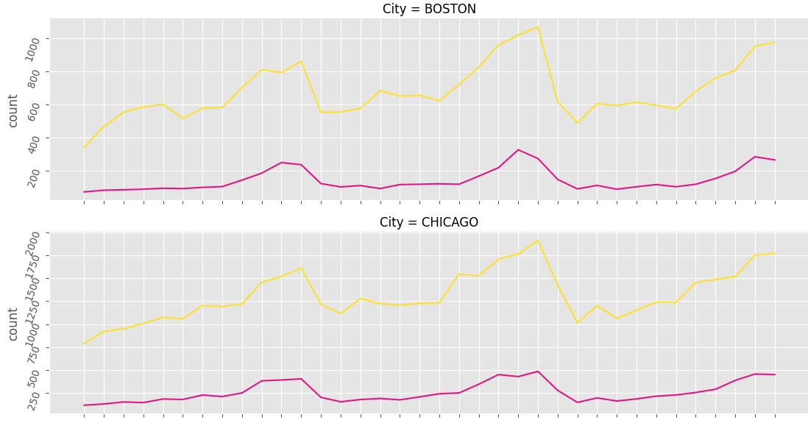
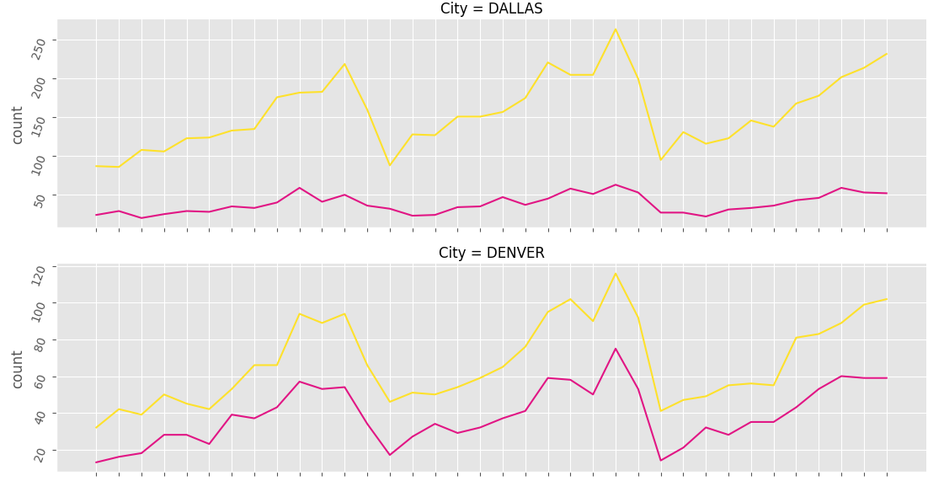
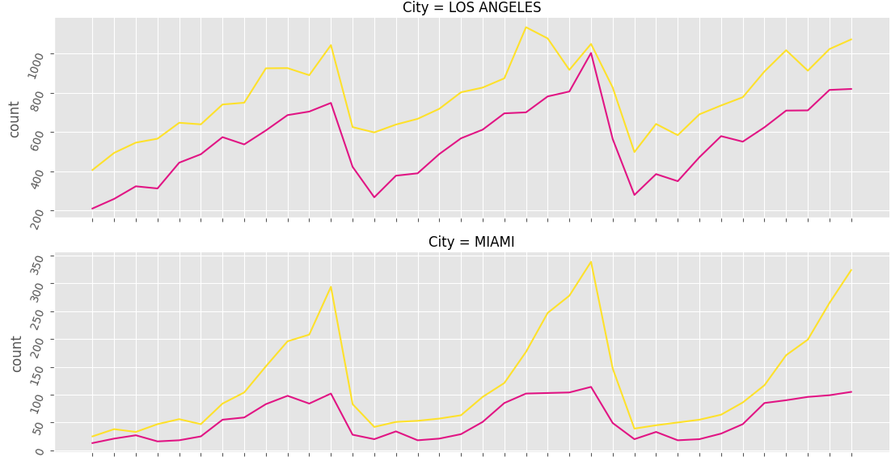
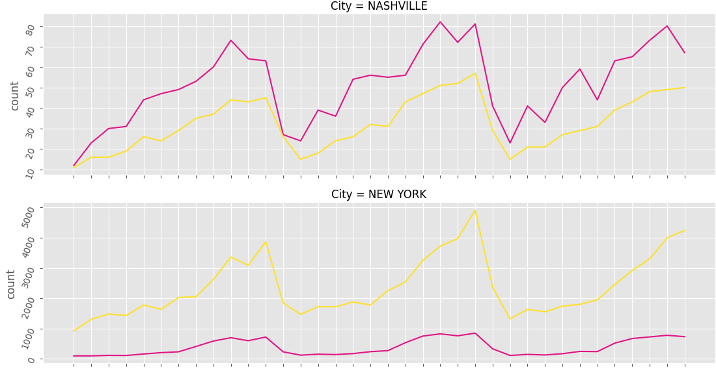
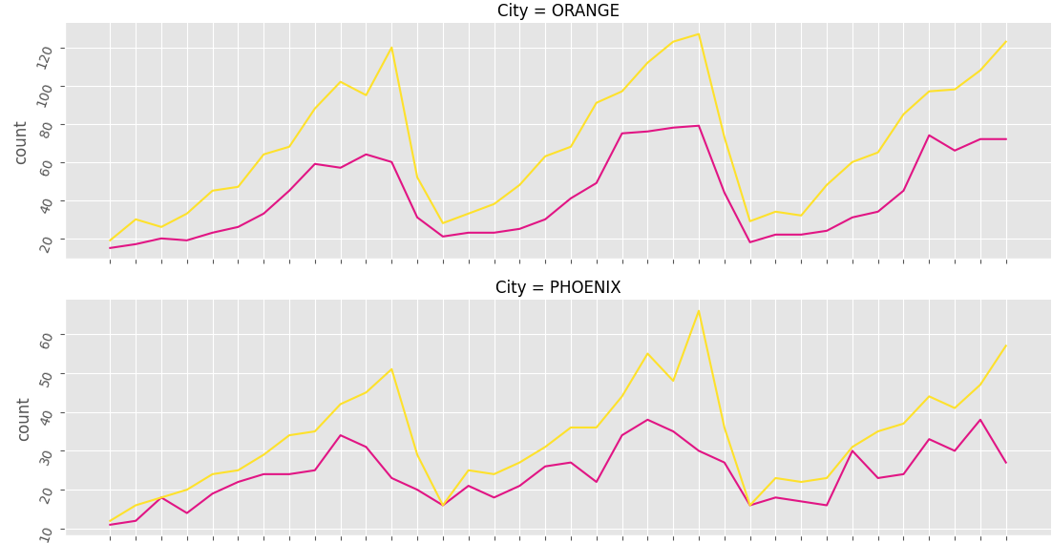
Seasonality Analysis - Across Cities

Slide 12
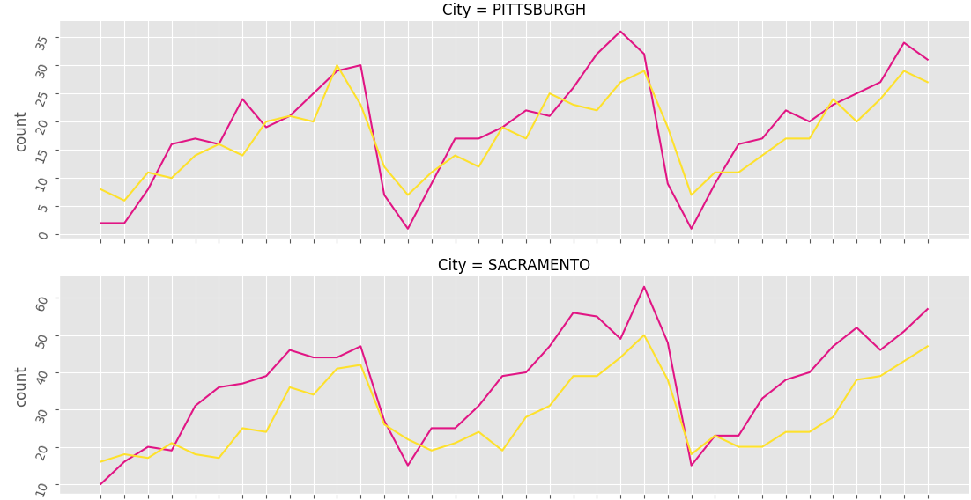
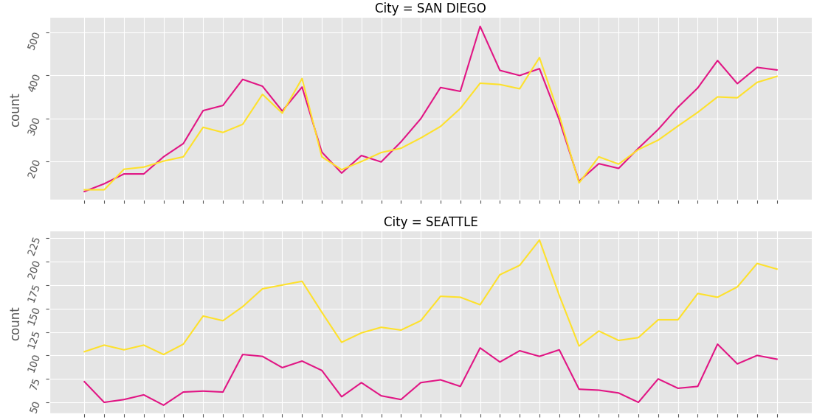
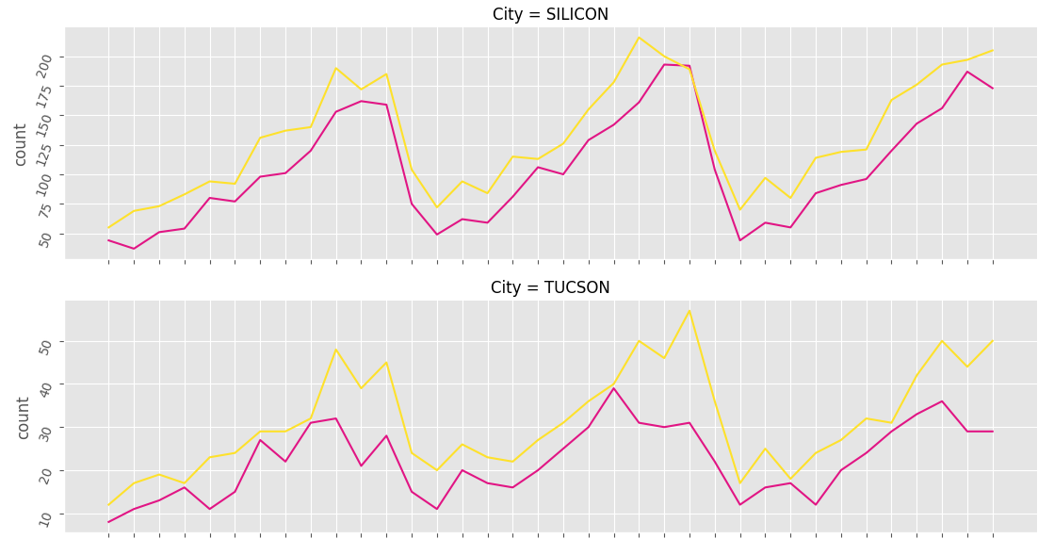
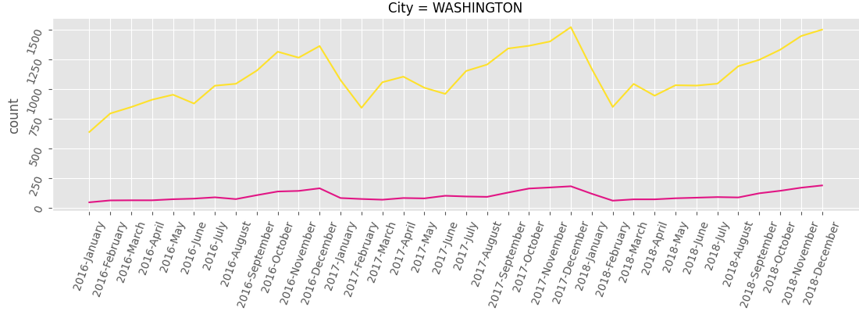
Seasonality Analysis - Across Cities
Overall, Yellow Cab company seems to perform during the given time period.
Pink Cab has more trips in only 2 cities: Nashville and Sacramento.

Slide 13
Recommendations
We have evaluated both the cab companies on following points and found Yellow cab better than Pink cab:
Customer Reach : Yellow cab has observed higher transactions in all cities for the given time period. We have also observed that Yellow cab is doing good in covering other cab users as compared to Pink cab.
Average Profit per KM: Yellow cab’s average profit per KM is almost three times the average profit per KM of the Pink cab.
Demand wise Reach : Yellow Cab's market share is greater than Pink Cab in most cities. Demand for Yellow cabs keeps increasing compared to Pink Cabs.
Seasonality in the demand : Overall, Yellow Cab company seems to perform during the given time period. Pink Cab has more trips in only 2 cities: Nashville and Sacramento.
On the basis of above points , we will recommend Yellow cab for investment.

Slide 14
Thank You

